Slide 1
Maailma Energeetikanõukogu
Uuringud ja tegevus
Mihkel Härm
Peasekretär
Maailma Energeetikanõukogu ERK
Eesti Teaduste Akadeemia
Kohtu 6, Tallinn
18.11.2015

Slide 2
Ettekande sisu
Maailma Energeetikanõukogu
World Energy Trilemma
World Energy Scenarios
Arutelu

Slide 3
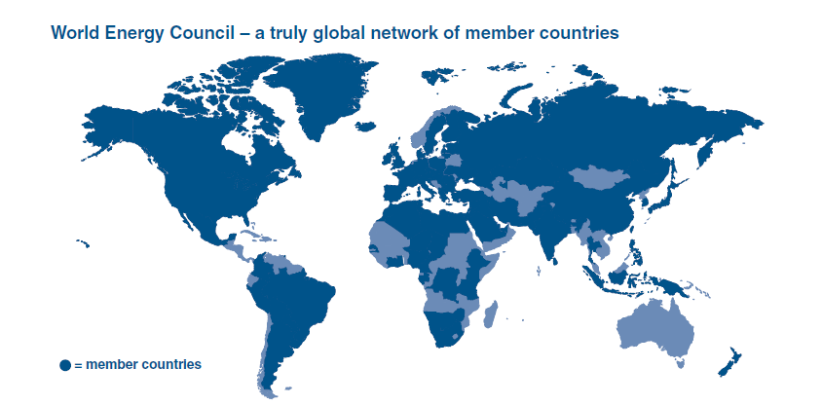
Maailma Energeetikanõukogu
Eesti liitus esmakordselt 1937. aastal.
Eesti liikmelisus taastati 1998. aastal.

Slide 4
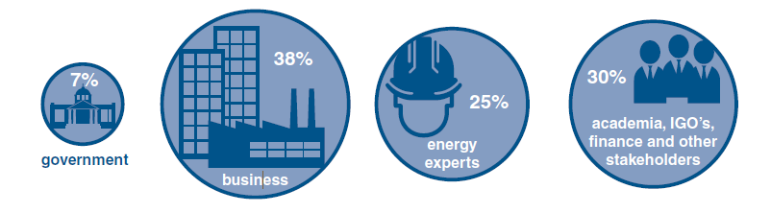
Maailma Energeetikanõukogu
Eesti rahvuskomitee liikmed (seisuga 18.11.2015)
- Teaduste Akadeemia - Eesti Energia
- Tallinna Tehnikaülikool - Eesti Elektritööstuseliit
- MKM - Eesti Gaas
- Keskkonnaministeerium - Eesti Gaasiliit

Slide 5
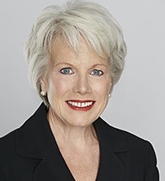
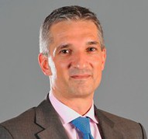
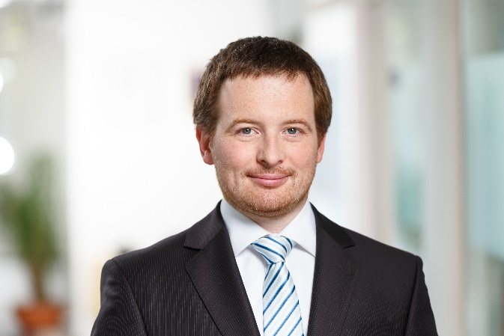
Maailma Energeetikanõukogu – inimesed
Peakontor
President Marie-José Nadeau
Peasekretär Christoph Frei
Eesti rahvuskomitee
Juhatuse esimees Margus Vals
Peasekretär Mihkel Härm

Slide 6
Maailma Energeetikanõukogu tegevus
Peamised uuringud
  World Energy Trilemma Eesti osaleb.
  World Energy Resources Eesti osaleb.
  World Energy Scenarios Eesti osaleb.
  World Energy Issues Monitor Eesti kohta on eraldi raport.
Üritused
  World Energy Congress
  Peaassamblee (Eestis toimus aastal 2006)
  Regionaalsed üritused, sh 2015 Eestis toimunud Baltic Sea Roundtable.
  Riiklikud üritused, sh erinevad konverentsid ja seminarid Eestis.

Slide 7
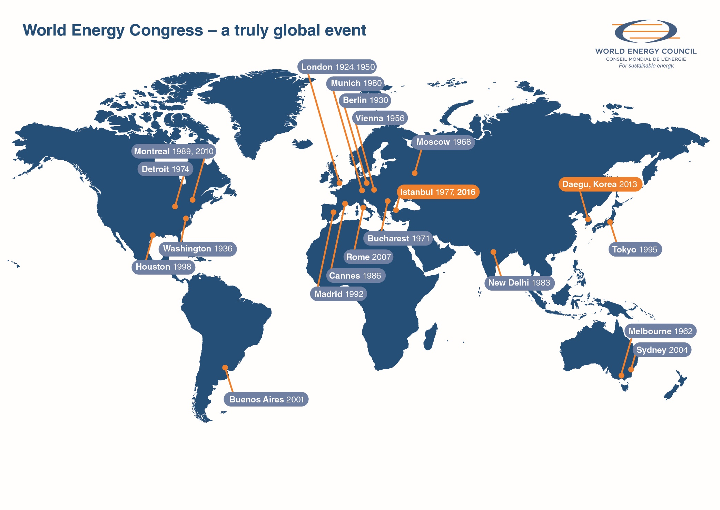
2019
Abu Dhabi

Slide 8
World Energy Trilemma

Slide 9
Myth 3: We can reduce global GHG emissions by 50% by 2050
Emissions trajectories for atmospheric GHG concentration
IPCC Categories
(CO₂ – eq)

Slide 10
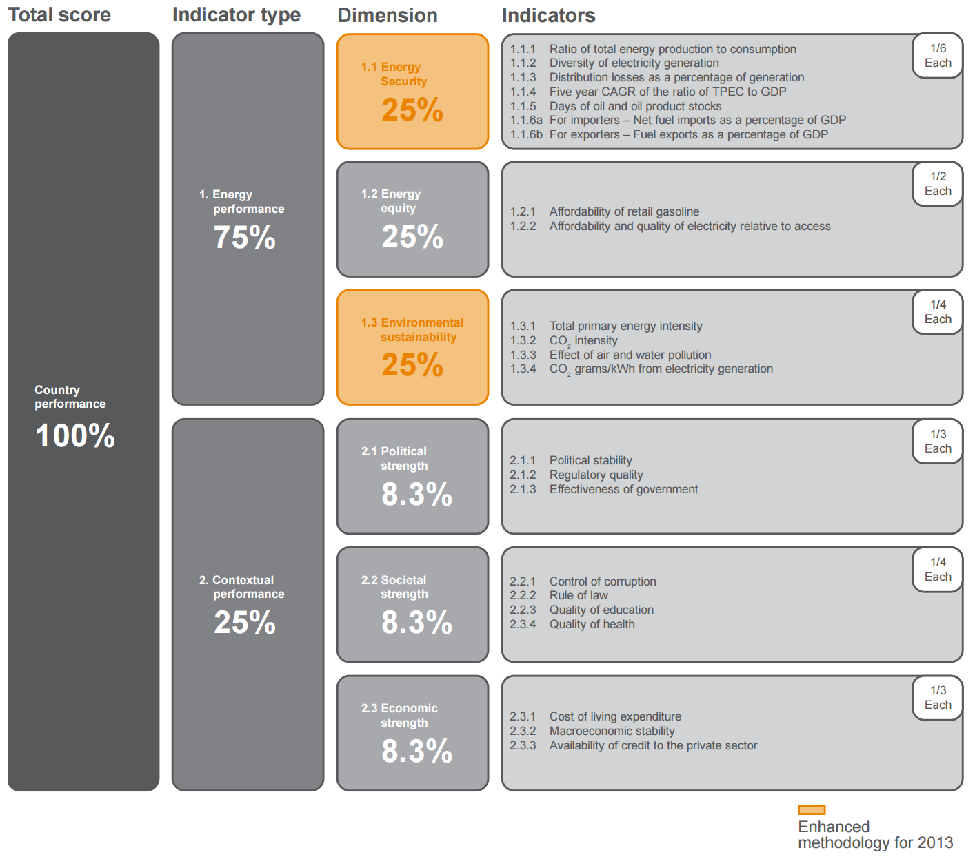

Slide 12
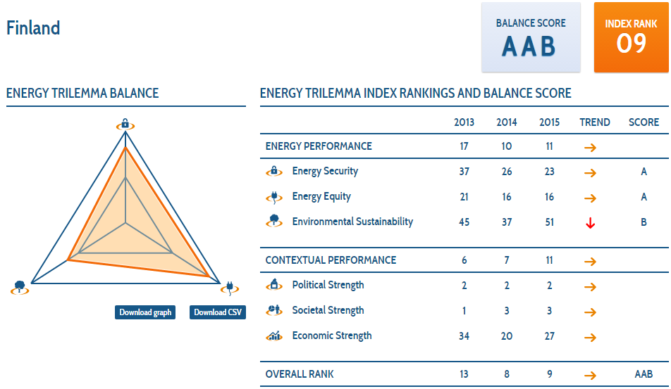

Slide 13
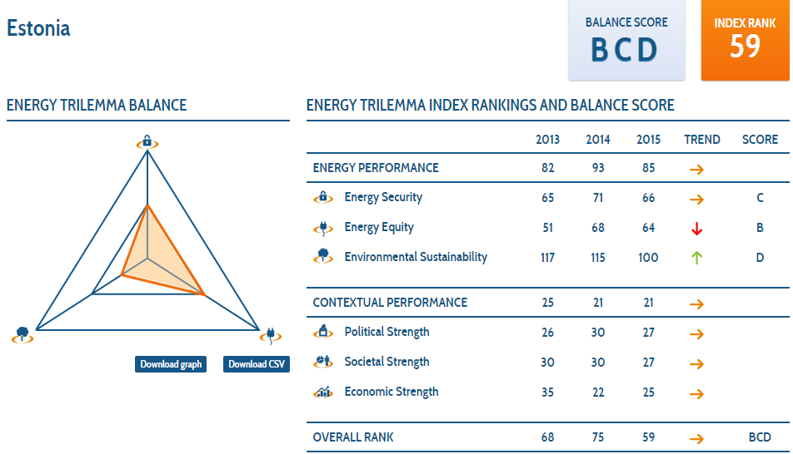

Slide 14
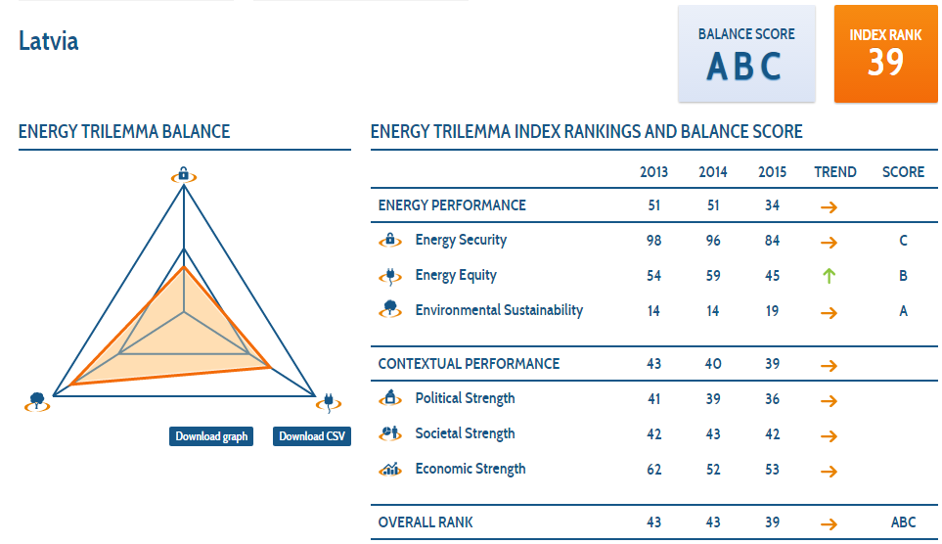

Slide 15
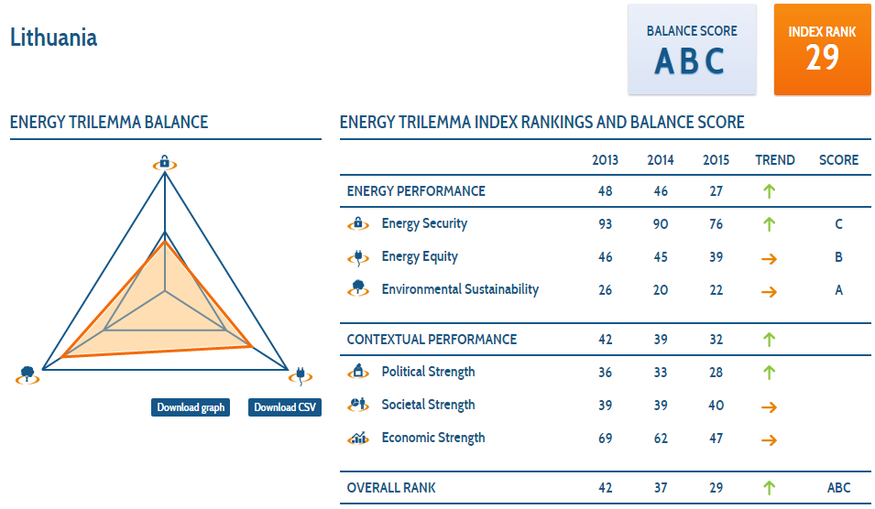

Slide 16
Trilemma uuringu järeldused
Edusammud on nähtavad…
  Energiaefektiivsus ja taastuvenergia osakaal kasvavad.
  Energia kättesaadavus paraneb.
… aga progress aeglane.
Vaja on investeerimiskindlust, selleks on vaja stabiilset poliitilist keskkonda.
Eesti positsioon on tingitud CO2 emissioonidest.

Slide 17
World Energy Issues monitor

Slide 18
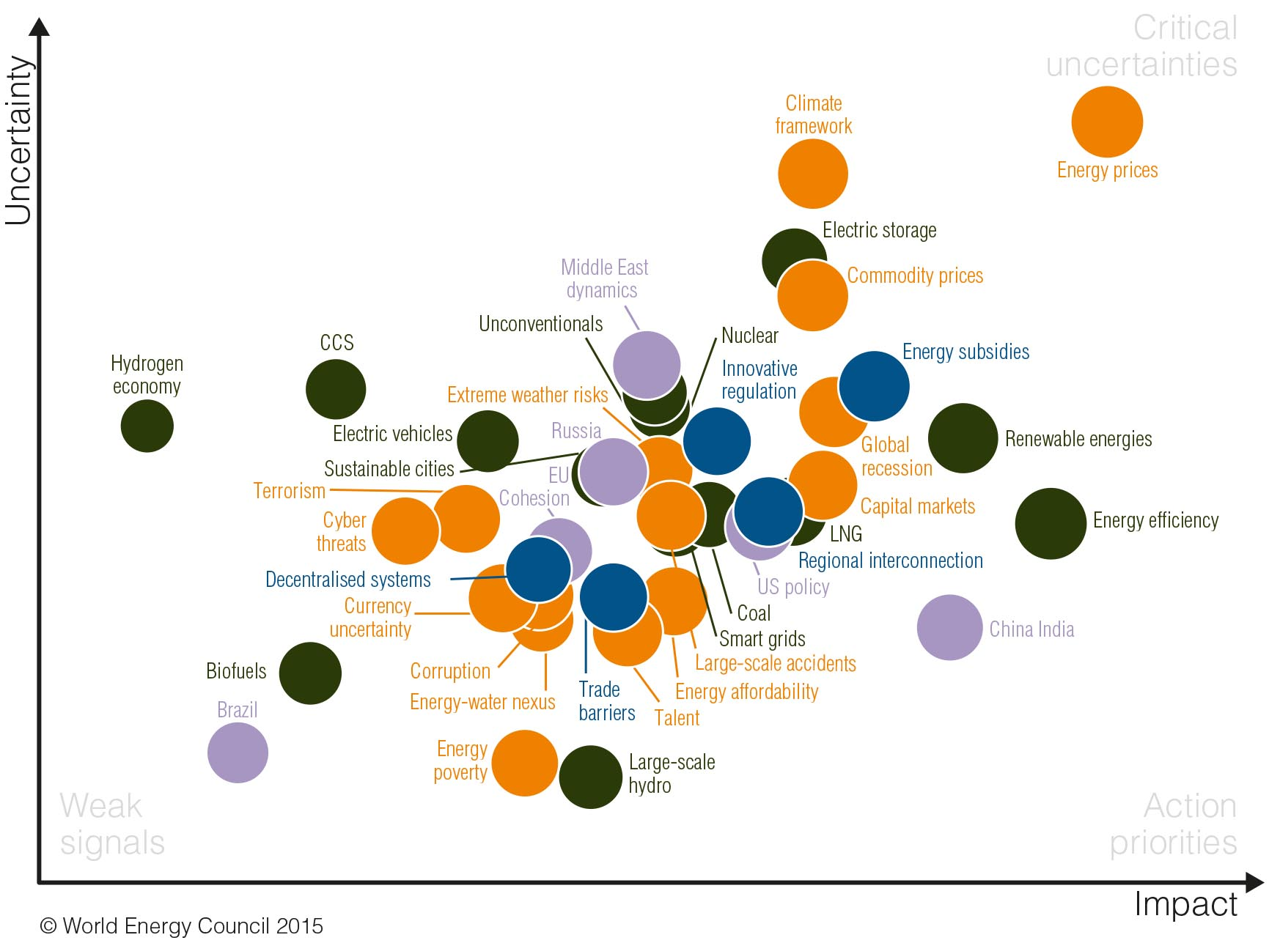
World Energy Issues Monitor 2015
World
© World Energy Council 2015

Slide 19
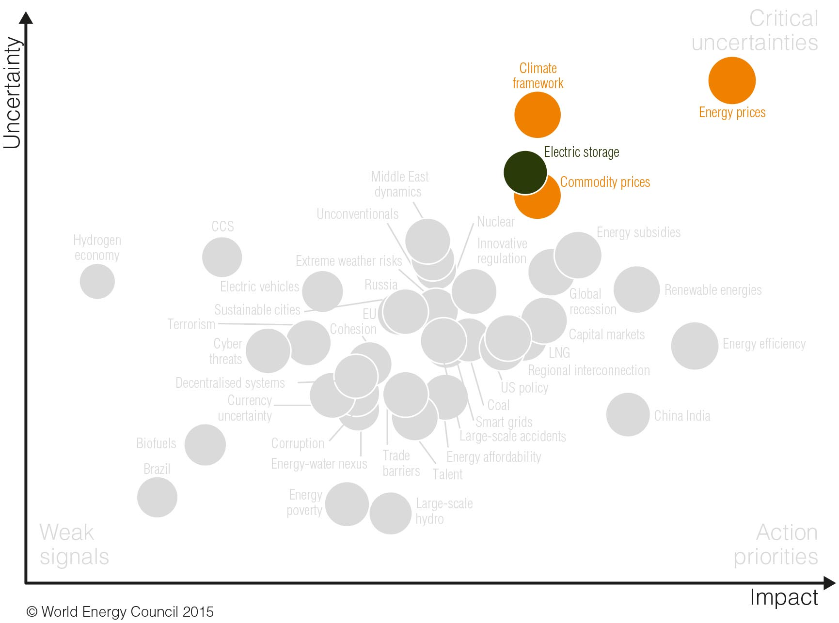
World Energy Issues Monitor 2015
World
Critical uncertainties
© World Energy Council 2015

Slide 20
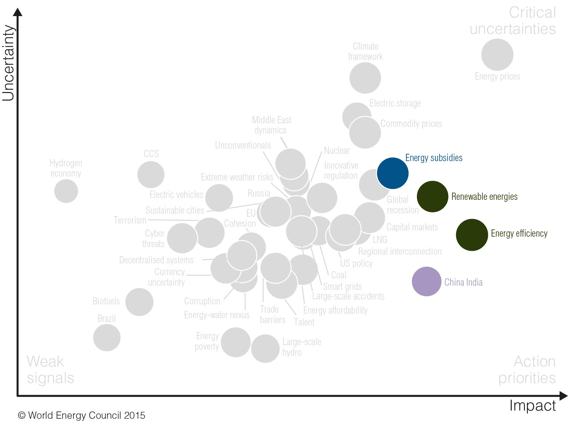
World Energy Issues Monitor 2015
World
Action priorities
© World Energy Council 2015

Slide 21
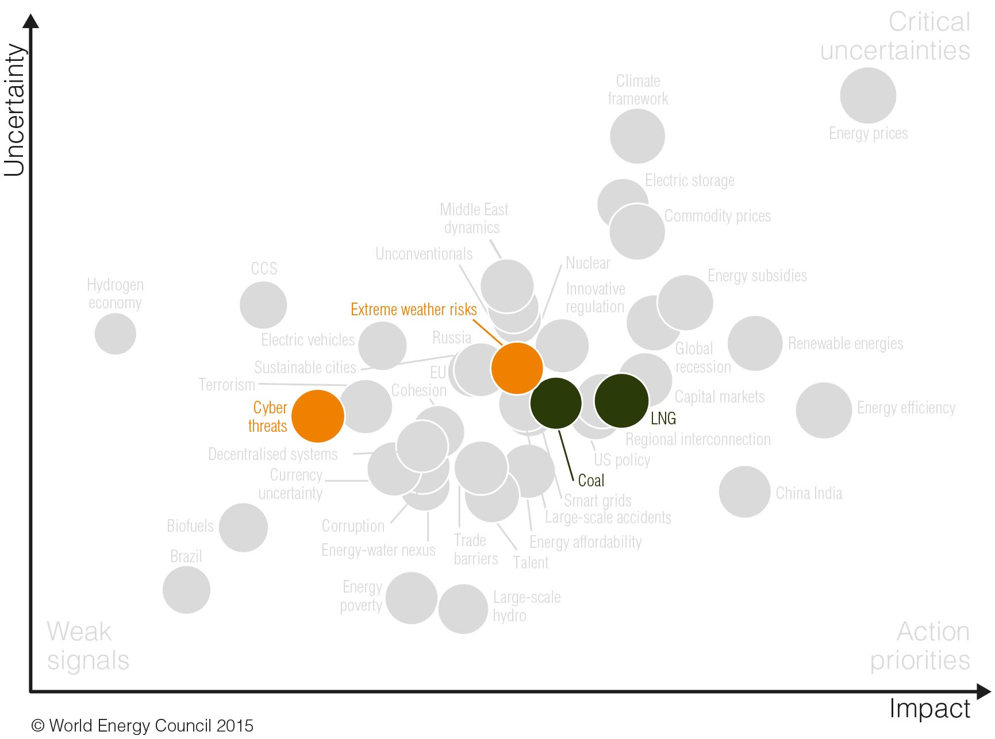
World Energy Issues Monitor 2015
World
New issues in 2015
© World Energy Council 2015

Slide 22
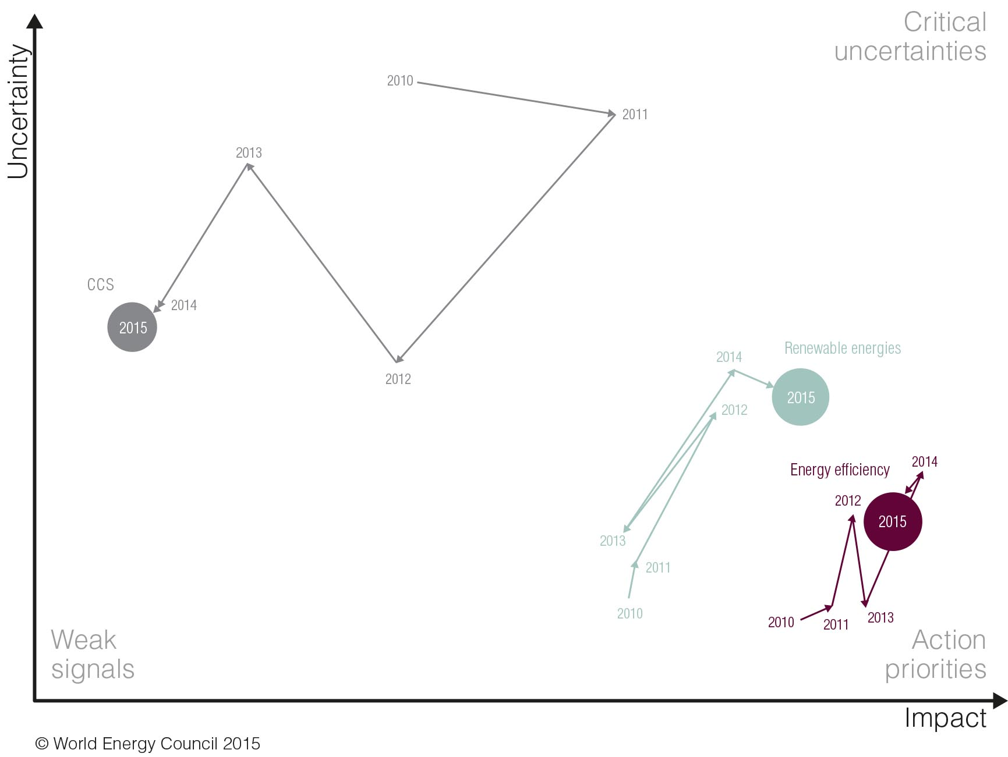
World Energy Issues Monitor 2015
World
Timelapse
© World Energy Council 2015

Slide 23
Euroopa

Slide 24
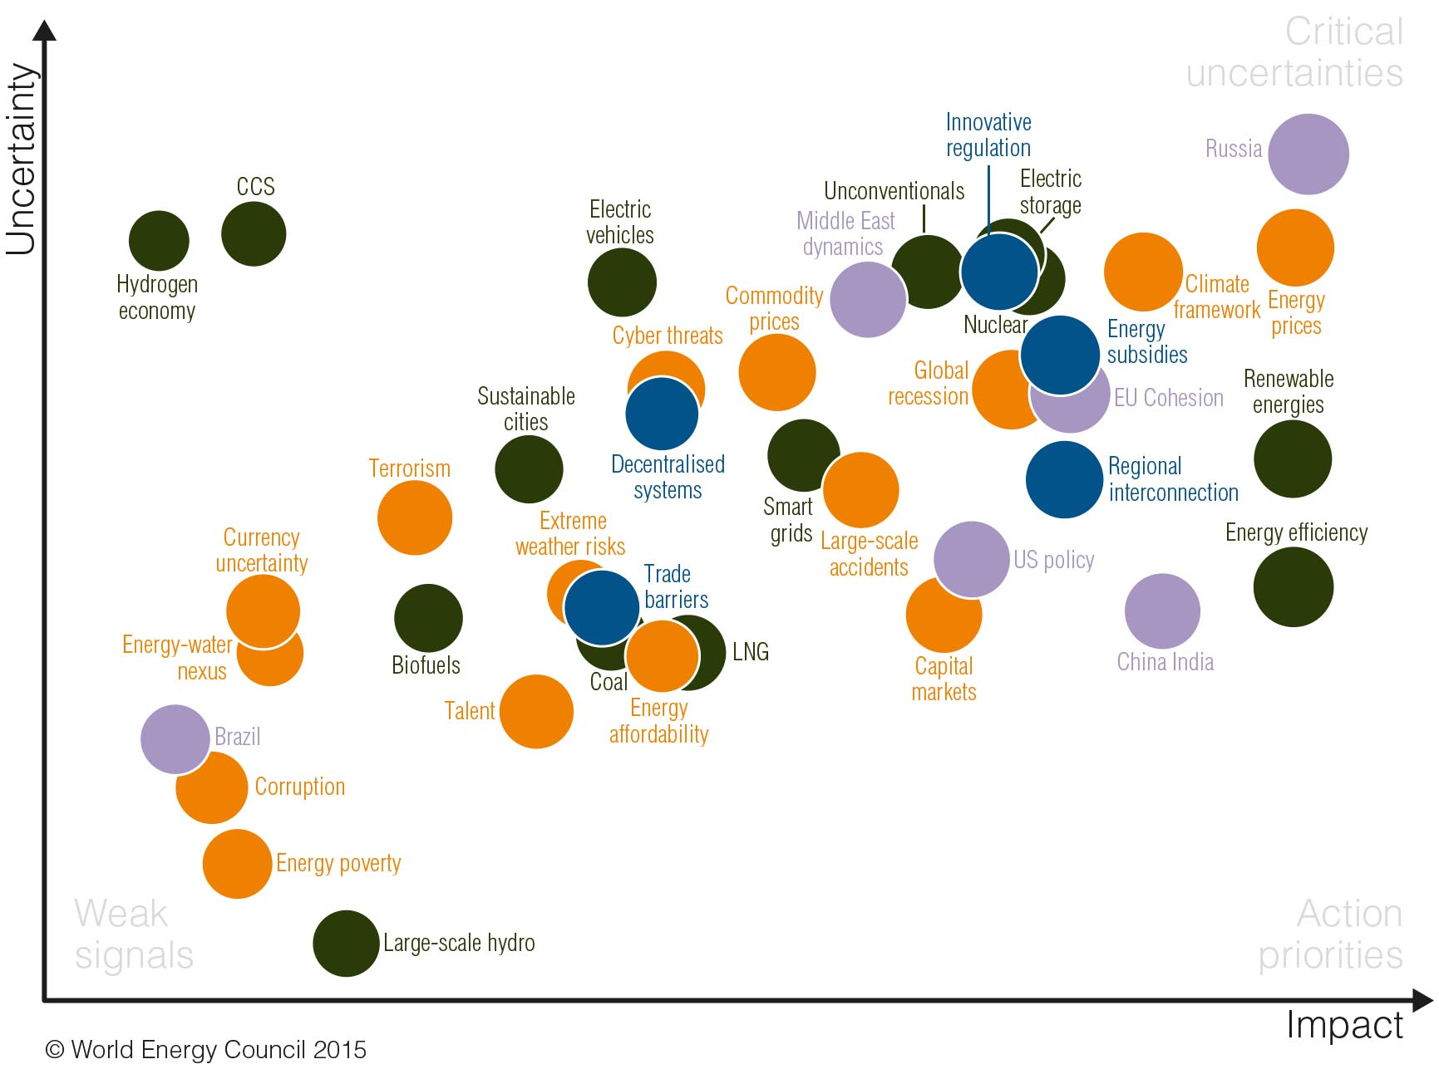
World Energy Issues Monitor 2015
Europe
Notes:
Venemaa mõju oluliselt suurem
Regionaalse koostöö mõju suurem
LNG mõju oluliselt väiksem

Slide 25
World Energy Issues Monitor 2015
World
© World Energy Council 2015

Slide 26
World Energy Issues Monitor 2015
Europe
Notes:
Venemaa mõju oluliselt suurem
Regionaalse koostöö mõju suurem
LNG mõju oluliselt väiksem

Slide 27
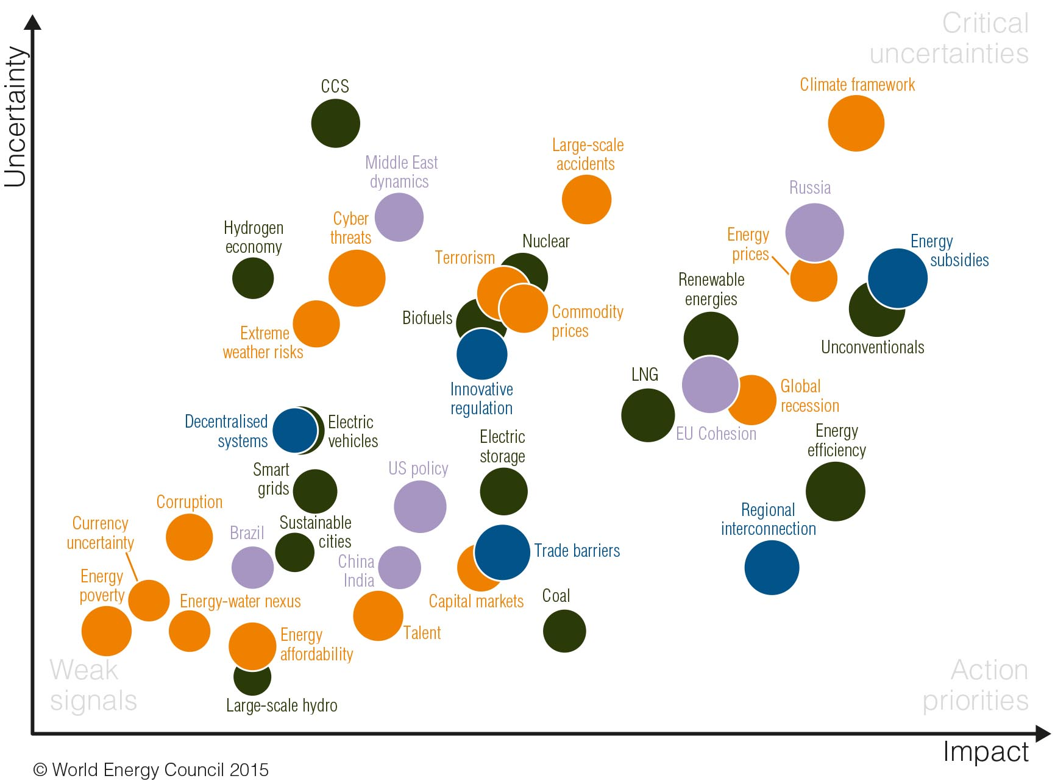
World Energy Issues Monitor 2015
Europe
Estonia
Notes:
LNG ja CCS ebamäärasus oluliselt kõrgem

Slide 28
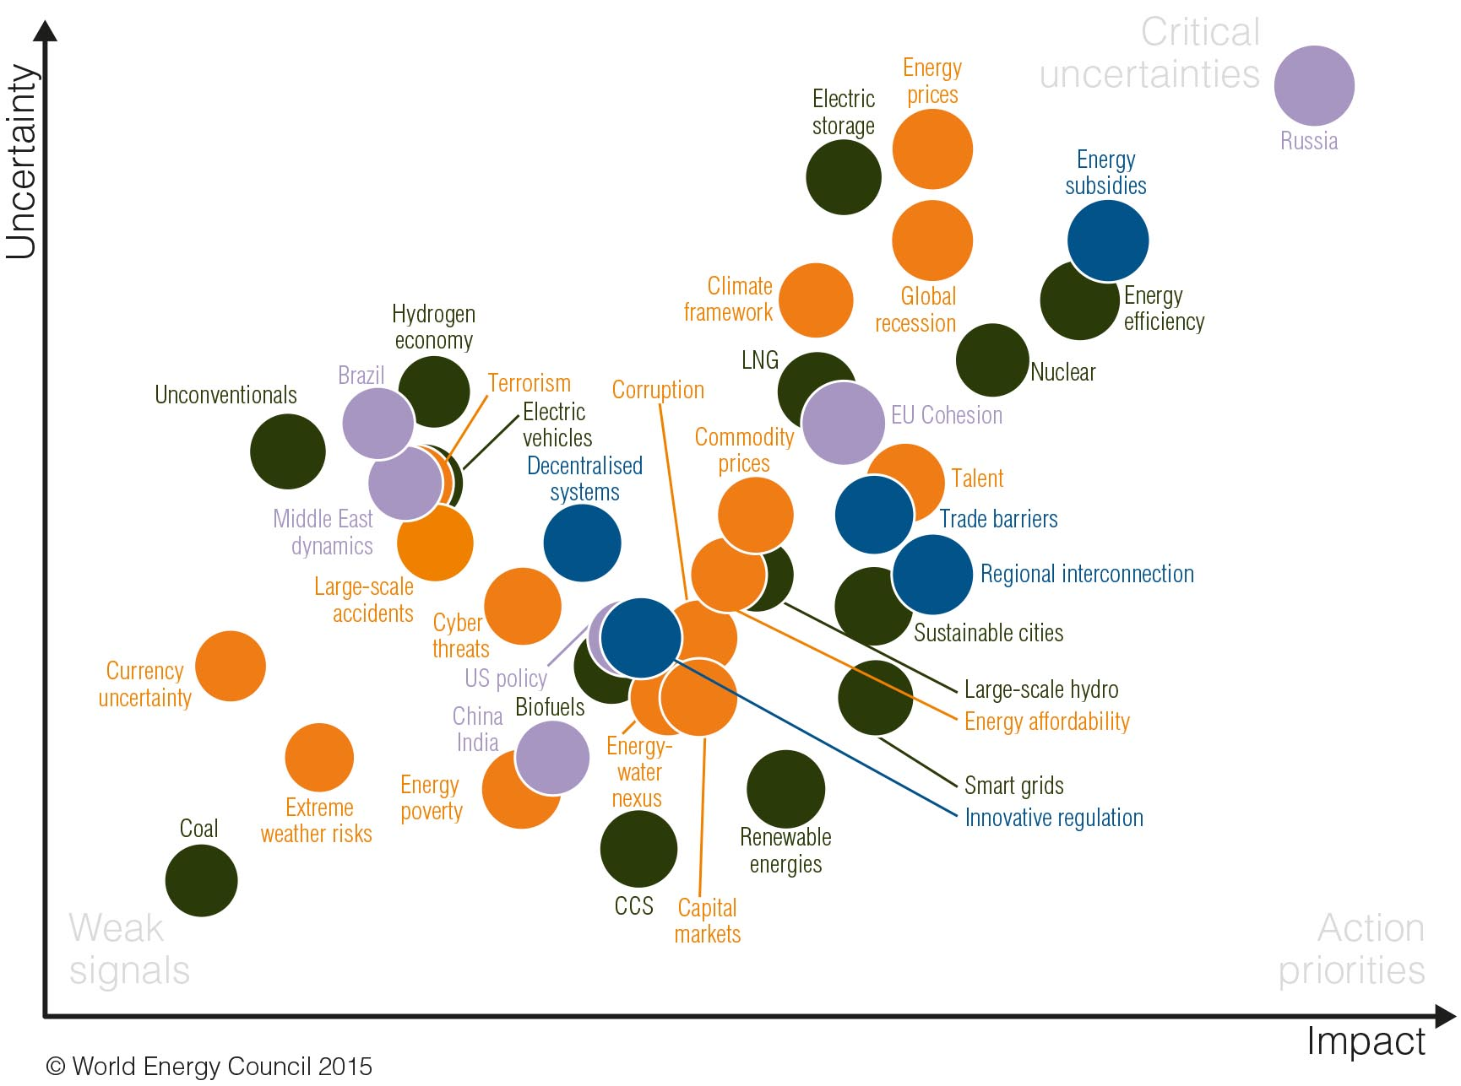
World Energy Issues Monitor 2015
Europe
Latvia

Slide 29
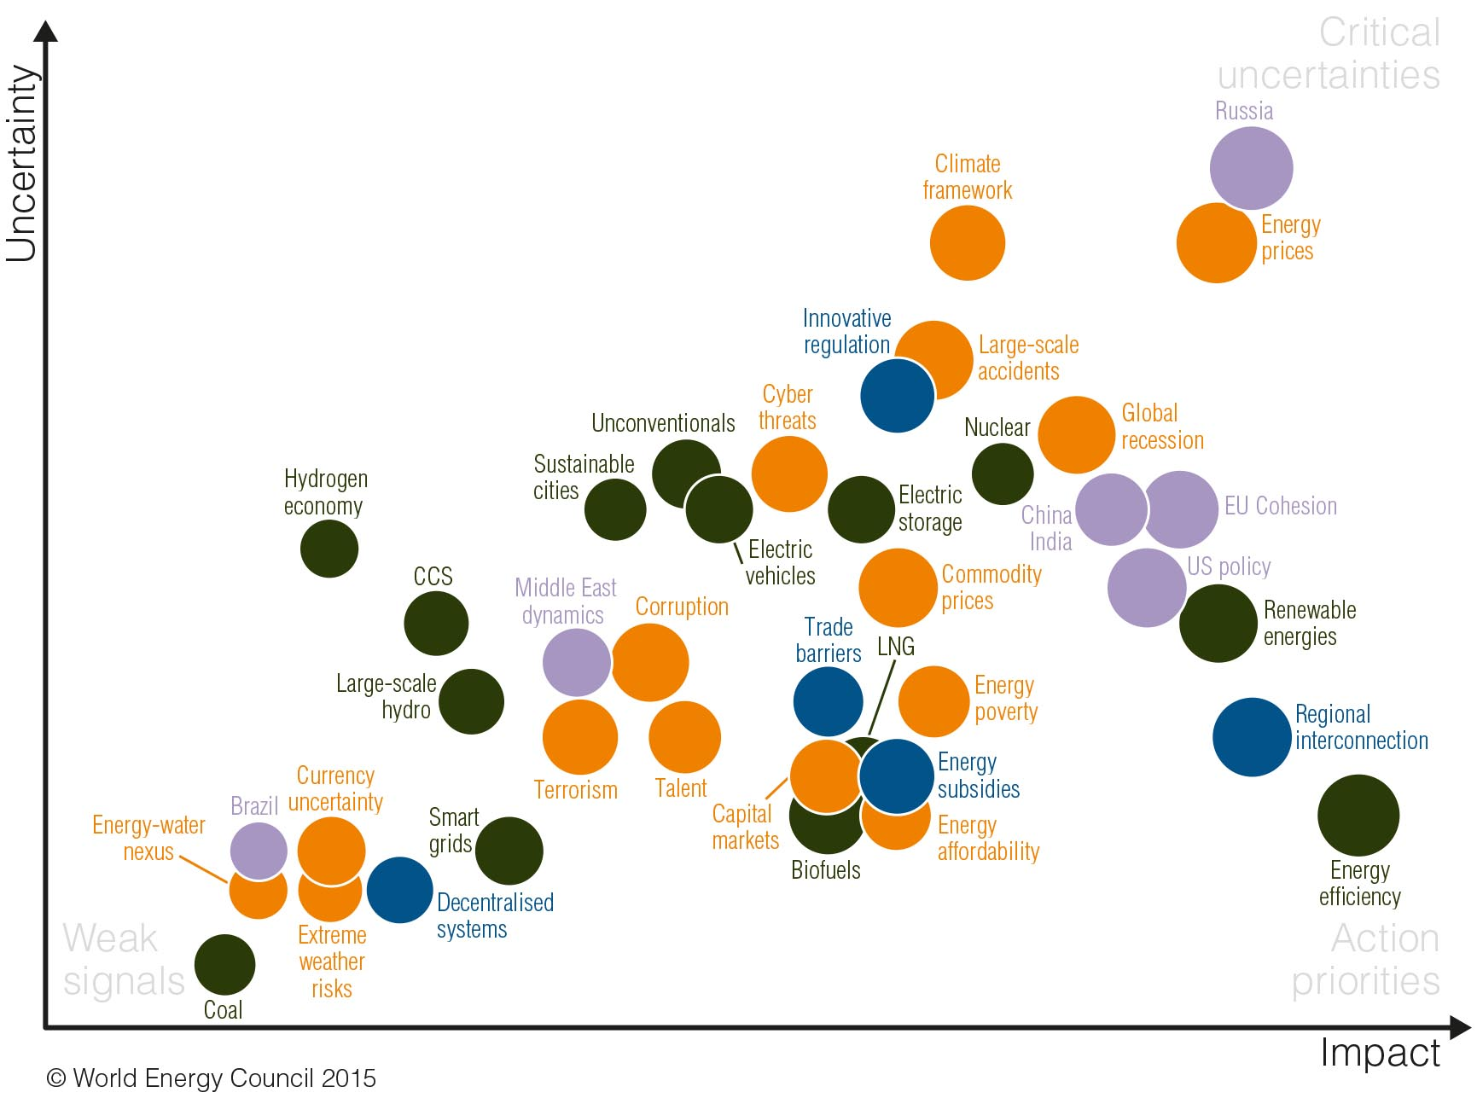
World Energy Issues Monitor 2015
Europe
Lithuania

Slide 30
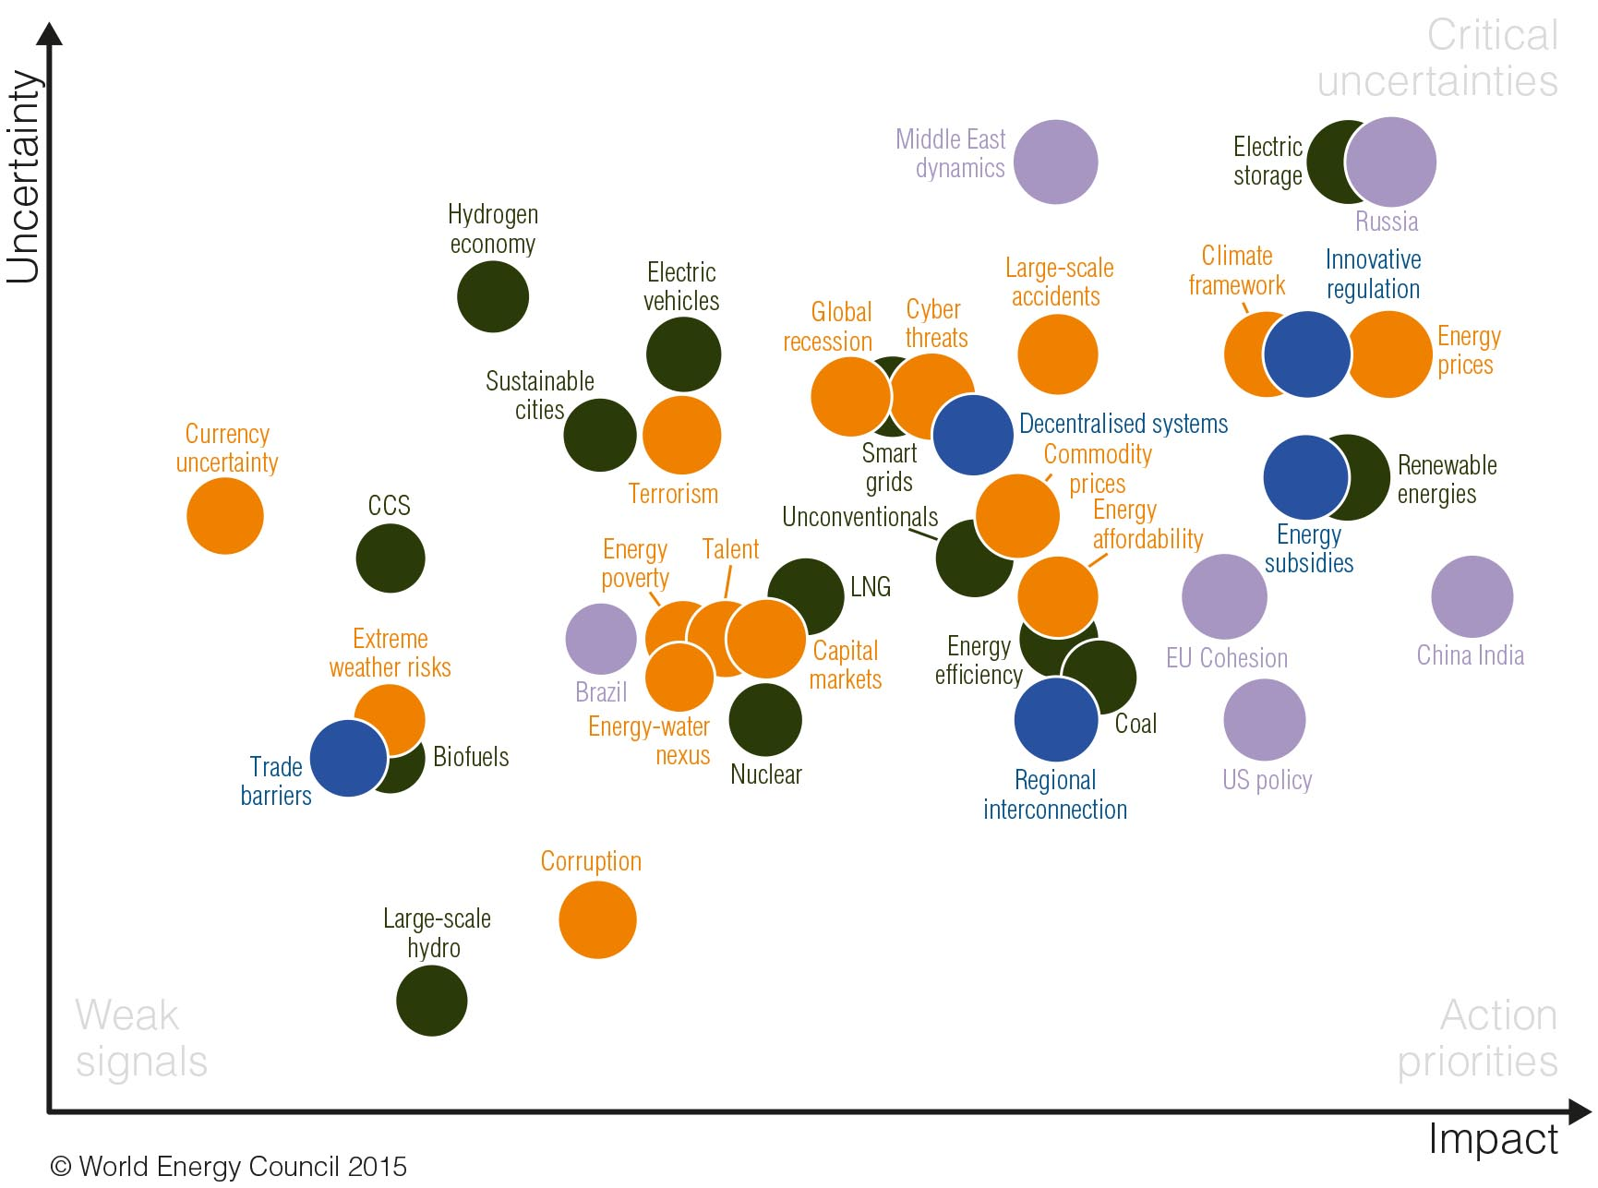
World Energy Issues Monitor 2015
Europe
Germany

Slide 31
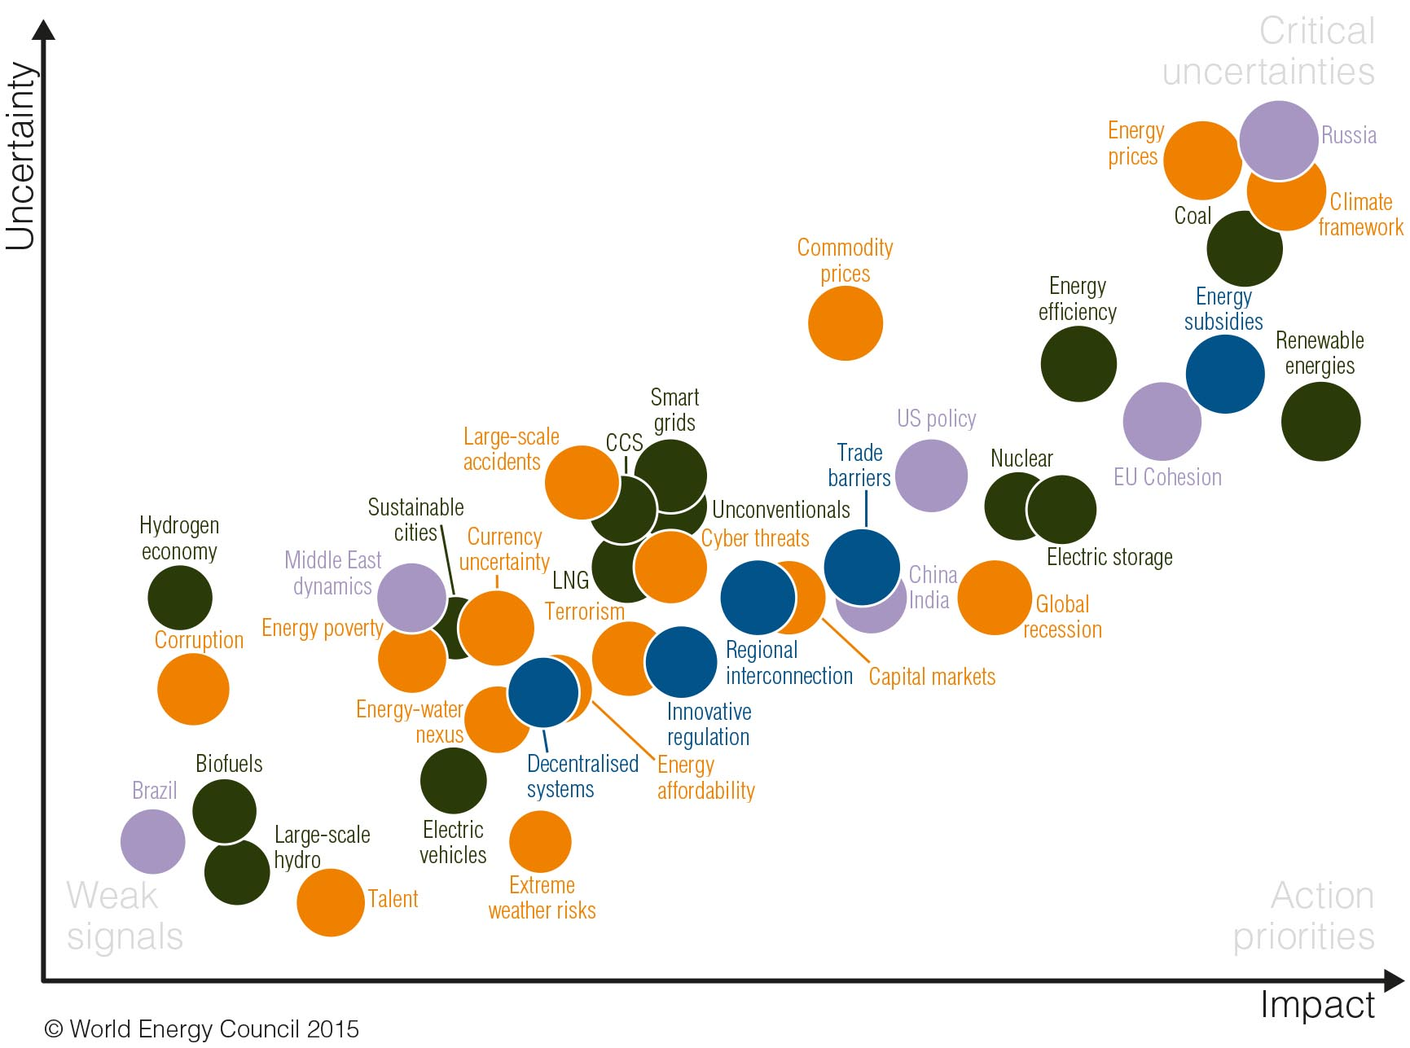
World Energy Issues Monitor 2015
Europe
Poland

Slide 32
World Energy Scenarios

Slide 33
Mis võib järgmise 100 aastaga juhtuda
Ameerikas elab 500 miljonit inimest
Soe ja külm õhk tuleb kraanist
Rongid sõidavad 250 km/h
Kõik kõnnivad vähemalt 10 km päevas
Autod on odavamad kui hobused
Poest saab osta valmistoitu
On võimalik näha kõikjale maailmas
Igal pool on telefonid
Pilte saab telegraafiga edastada
Inimesed on pikemad
Kivisütt ei kasutada
Õhulaevad on olemas
Herned on sama suured kui peedid
Ladies’ Home Journal
Detsember, 1900

Slide 34
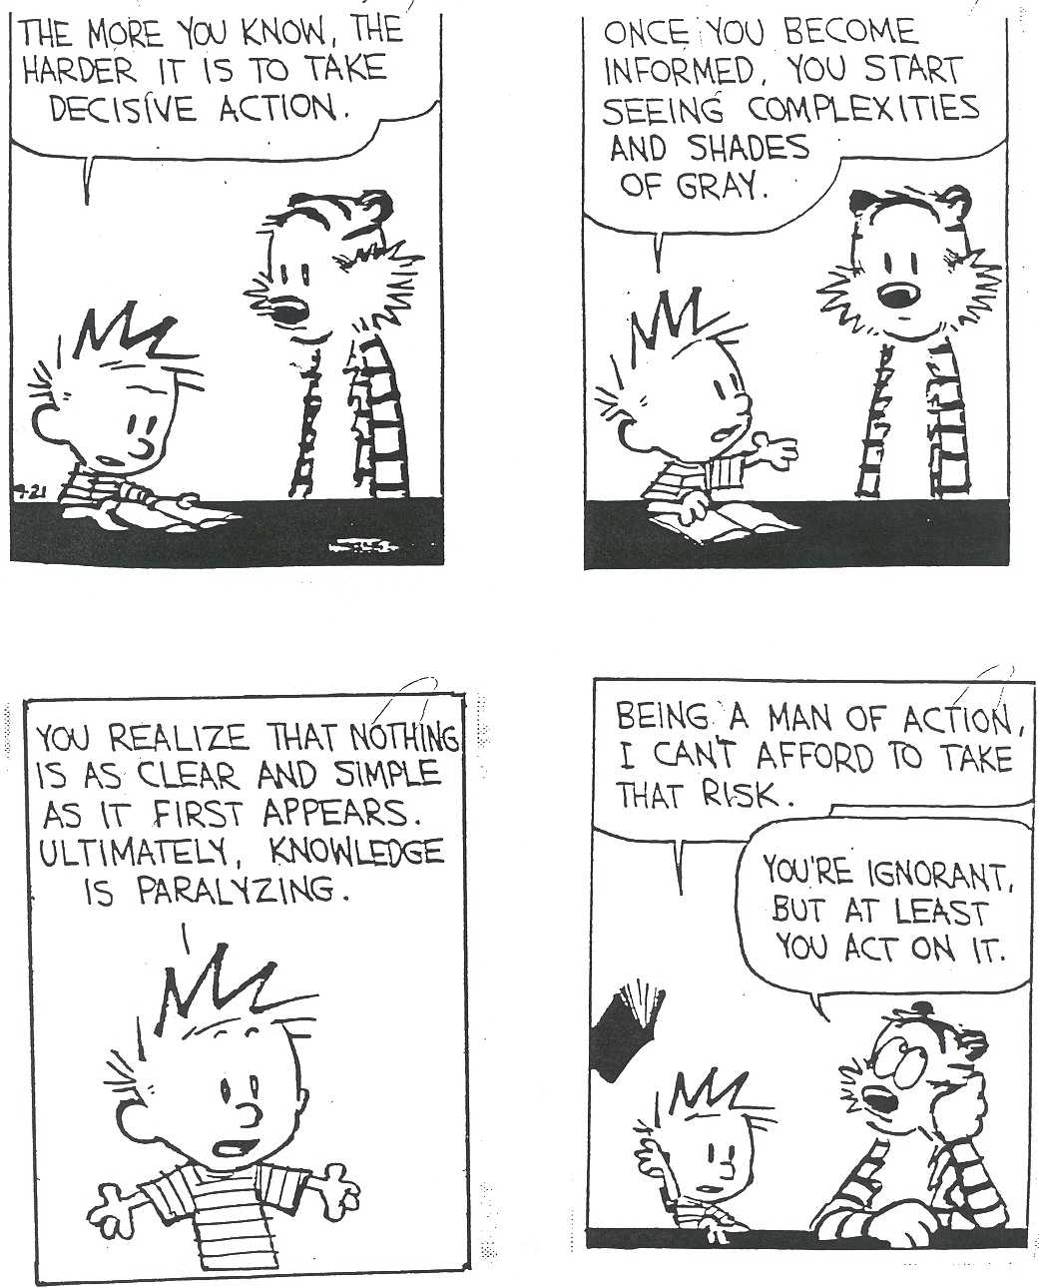

Slide 35
Stsenaariumid WEC-i käsitluses
Stsenaariumid EI OLE tuleviku ennustamine
Stsenaariumid on alternatiivsed tulevikud
Strateegiad ja plaanid, kuidas käituda
Küsimused, MITTE vastused
Fookus on järgmisel 1-3 aastal
Mida teha täna, et aastal 2060 oleks tõenäosus soovitud tuleviku osas suurem
Notes:
Scenarios are not projections, predictions or preferences. Rather they are coherent and credible stories, describing different paths that lead to alternative futures.
The process of producing and using scenarios is as important as the actual scenario stories themselves. Building and using scenarios is about asking questions, rather than providing answers. The process is intended to widen our perspectives, helping us to understand issues and events as significant, which we might otherwise dismiss as unimportant or just not see at all.
Scenarios should focus on the near future that is on the policy and strategy agenda of the next 1-3 years and less on the scenario horizon.

Slide 36
Olulised trendid

Slide 37
Odavam päikese energia
Päikese energia kasutamine on muutunud viimastel aastatel oluliselt odavamaks, ilmselt trend jätkub.
Source: Lazard LCOE, Clean Energy Business Council Outlook for PV
Notes:
The IEA recently published its solar PV and Solar Thermal Roadmaps out to 2050, and estimated that with the right policies, Solar PV could take 16% of electricity share and Solar Thermal could take 10% of electricity share by 2050. That means solar could reflect 26% of electricity share by 2050! Is that possible? Can the system handle it?

Slide 38
Võrguettevõtte ärimudel peab muutuma
Integreeritud hajavõrgud
Nutikas regulatsioon võimaldab kasutada uusi tehnoloogiaid
Nutivõrk
Paindlik regulatsioon
Võrk kui vahendaja ja turuplats
Hinnakujunduse reform
Uued ärimudelid
Uus regulatsioon
Muutunud tarbijakäitumine
Odav päikese energia, salvestamine, EV, efektiivsus, tarbimise juhtimine
Regulatsioon ja ärimudelid ei jõua tehnoloogiaga sammud pidada
Hajatootmine ainult enda tarbeks
Võrgust eraldumine
Võrgus on ülevõimsused ja asjatud investeeringud
Stranded assets – nii tarbijal, tootjal kui võrgul
Off-grid
Notes:
This is just one example of an uncertainty that could lead to an inflection point in the future of energy. In the Jazz and Symphony model we see a governance structure come into action that is effective and can influence outcomes in the market. That is a big assumption, it may be that the technology makes decisions for us.

Slide 39
Nafta hinna tulevik?
Price evolution
Annual Average
Brent Price
2014 $
OPEC’s
market
power
Growth of North Sea,
Gulf of Mexico &
S and Central America
OPEC’s
market
power
Growth
of U.S. LTO
A
B
Low breakeven price
and plentiful supply
C
Source: Schlumberger Business Consulting

Slide 40
Kildagaas ja kildaõli – nafta hinna piirajad?
BASIN BREAKEVEN OIL PRICE PER BARREL
Marcellus Shale ‐ SW liquids rich | $24.23
Marcellus Shale ‐ Super Rich | $25.63
Utica ‐ Wet gas | $32.39
Mississippian Horizontal ‐ East | $42.15
Utica ‐ Liquids Rich | $44.04
Eagle Ford ‐ Liquids Rich | $46.05
Niobrara ‐ Wattenberg | $46.10
Wolfcamp ‐ N. Midland (Horizontal) | $53.92
Eagle Ford ‐ Oil Window | $55.29
Wolfcamp ‐ S. Midland (Horizontal) | $61.57
Mississippian Horizontal ‐ West | $64.05
Wolfberry | $64.63
Bakken Shale | $64.74
Wolfcamp ‐ N. Delaware (Horizontal) | $68.54
Uinta ‐ Green River | $68.77
Uinta ‐ Wasatch (H) | $72.15
Granite Wash ‐ Liquids Rich Horizontal | $73.10
Uinta ‐ Wasatch (V) | $74.95
Barnett Shale ‐ Southern Liquids Rich | $84.45
US Crude Oil Production (MMBPD)
US Natural Gas Production (BCM)
Source: Credit Suisse
Source: EIA
Notes:
Green portion reflects the best leases within the Marcellus and Utica shale basins. In total they represent 2% of oil production and 42% of gas production from Unconventional basis. Upside in these basins comes from higher quality condensates and NGLs associated with these wet gas plays.
Yellow portion reflects some overlap with Utica, but mostly accounts for the Eagle Ford and Niobrara basins which reflected 38% of oil production and 26% of gas production from unconventional basins.
Similar to the Solar story. The US Unconventionals story is about standardization and application of technology with a manufacturing mindset in the oilfield. The fracturing innovation came from the service companies, and the operators applied analytics, mobility solutions, and other digital technologies to measure their performance and deliver projects with solid returns. Leading operators track every detail of cost and production and aggressively use data and technology to drive their decision making and resource allocation. The big IOCs have been slower to capitalize on this trend; they are too siloed and not adaptable enough to drive the same efficiencies as the small independents.
The impact has been incredible, with the volumes from the top 7 Unconventional Basins now representing more than half of total production in the US.
The interviewees all agreed, the US Unconvtentionals story has changed the shape of the global oil and has markets. (A2, K2, K3, G4, G2)
It shifted the geopolitical positioning of the Middle East and OPEC
It lead to cheap coal flooding the market - US Coal exports are now going to the EU
It has provided additional supply thereby contributing to a lower price environment (commodity price volatility)

Slide 41
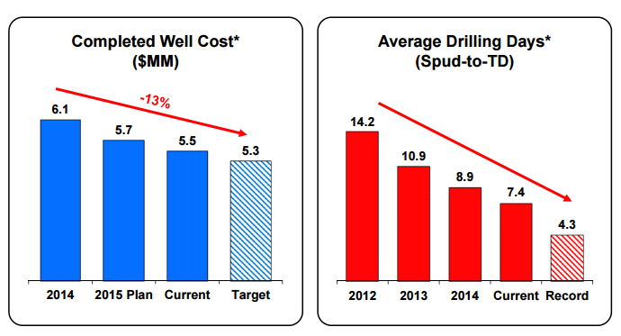
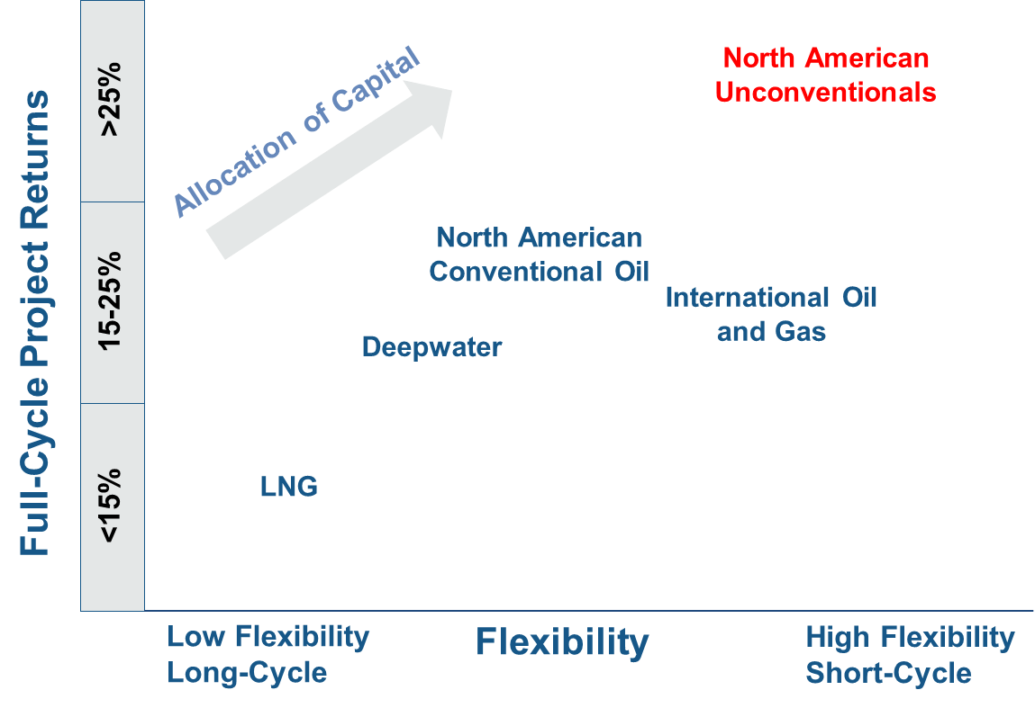
Kildaõli tootjad muutuvad järjest efektiivsemaks
EOG Eagle Ford Operations
Conoco Phillips: Flexibility vs. Returns by Asset Type
v
Completed Well Costs (MM USD)
6.1
-13%
5.7
5.5
5.3
2014
2015
Plan
Current
Target
v
Average Drilling Days
Spud to TD
14.2
10.9
8.9
7.4
4.3
2012
2013
2014
Current
Record
Source: EOG Investor Presentation, May 2015
Source: Conoco Phillips Investor Presentation, May 2015
Notes:
Unconventionals are reshaping business models for the oil and gas industry.
Despite the rapid decline in costs since 2011, there are still significant cost reduction and continuous improvement opportunities available in the high well count environment of shale and tight plays.
Costs continue to fall. The example on the left is for a leading US independent, EOG, in the Eagle Ford. They’ve taken learnings from their operations in the Barnett and have continued to drive down the time and cost to deliver their unconventional wells. Every quarter they publish more updates on the details of their improvements in operational performance. EOG delivers wells for 5.5 million dollars now. .
Despite the more than 50% decline in oil and natural gas prices in the last 12 months, upstream operators have continued to drill wells in North America, but are waiting to complete them, leading to a build-up of uncompleted wells. The EIA estimates there were somewhere between 2,000 and 4000 uncompleted wells in the US as of June 2015 This option to defer production allows Unconventional operators to use the rigs they have under multi-year contracts and builds an inventory of wells that can be completed quickly to capitalize on a price rebound. http://www.eia.gov/conference/2015/pdf/presentations/nulle.pdf, pg. 21
When I say quickly, I mean completing a well could take 1-3 months, the EIA estimates that the US has the potential to add 350,000 bpd of production by October 2016 if they were to complete all the uncompleted well inventory in the US. Completion times are continuing to decline enabling operators to bring production online in just a couple of months.
For oil and gas companies that have both conventional and unconventional assets in their portfolios, the short-cycle, cash flow profile, and continuously improving profitability of unconventional shale and tight plays have influenced the way they calculate the risk-weighted value of their portfolios and potential future investments. The example on the right is Conoco Phillips, who recently announced they are investing more in Unconventionals in this lower price environment. Their Unconventional projects in the US provide better returns and are more flexible than Deepwater, LNG, and even conventional projects. The flexibility comes from the operators freedom to drill the wells today at the lower service cost, and complete them next year when the price rebounds. The returns from the growing efficiencies and increasing productivity.
Full URL: http://www.conocophillips.com/investor-relations/Investor%20Presentation%20Documents/Investor%20Travel%20Deck-5142015.pdf

Slide 42
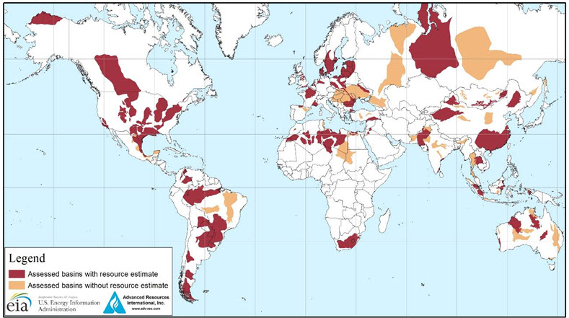
USA edulugu võib korduda paljudes teistes riikides
UK
Shale gas: 26 Tcf
Shale oil: 0.7bn Bbl.
Poland
Shale gas: 148 Tcf
Shale oil: 3.3bn Bbl.
Saudi Arabia
Shale gas: 600 Tcf
Russia
Shale gas: 287 Tcf
Shale oil: 75bn Bbl.
Canada
Shale gas: 573 Tcf
Shale oil: 9bn Bbl.
China
Shale gas:1,115 Tcf
Shale oil: 32bn Bbl.
United States
Shale gas: 665 Tcf Shale oil: 58bn Bbl.
Australia
Shale gas: 437 Tcf
Shale oil: 18bn Bbl.
Mexico
Shale gas: 545 Tcf
Shale oil: 13bn Bbl.
Argentina
Shale gas: 802 Tcf
Shale oil: 27bn Bbl.
South Africa
Shale gas: 390 Tcf
Tcf: Trillion cubic feet
Bbl: Barrel
Source: Technically Reoverable Shale Oil and Shale Gas Resources, EIA 2013

Slide 43
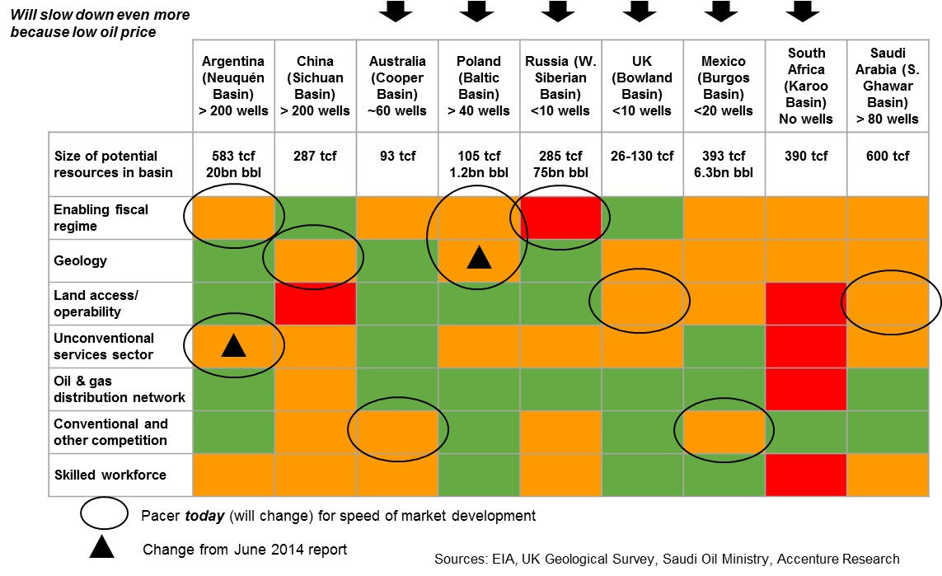
Kildagaas sõltub aga paljudest faktoritest
Notes:
Updated the UK number with local info. British Geological Survey (BGS) estimated 130 tcf (1,300 tcf reserve and 10% extractable) whereas EIA number was 26 tcf. So I put down a range of 26 - 130 tcf for the UK.

Slide 44
Energiasektori tippjuhtide intervjuudes kõlanud fraasid
SECURITY OF SUPPLY
PUBLIC AND PRIVATE
OIL AND GAS
CHANGE OF PARADIGM
FOOD AND WATER SUPPLY
SOLAR AND WIND
ROLE OF GOVERNMENT
GLOBAL SUPPLY CHAIN
CHINA AND INDIA
ELECTRIC POWER TRANSMISSION
CHANGES IN LIFESTYLE
ENERGY STORAGE SYSTEM
CLIMATE CHANGE AGENDA
FUTURE OF ENERGY
TERMS OF ENERGY
OUTCOME OF COP
FOOD AND WATER
DEBT UNDER CONTROL
GROWTH RATES OF CHINA
TECHNOLOGY CHANGES
ACCESS TO ENERGY
ELECTRICITY AND WATER
CONTROL OF THE ENERGY
IMPACT OF CHEAPER OIL
SOCIAL UPRISING
ELECTRIC POWER INDUSTRY
DEMAND FOR ENERGY
GLOBAL SUPPLY CHAINS
Notes:
Climate change emerged as key them, but was not discussed in every interview
In terms of the Energy sector, electric power is the main discussion topic, but only for one interviewee
China and India are a key discussion topic
Economic growth is more important than policy in the discussion
Renewables are discussed more than fossil fuels
But oil and gas are discussed more than any specific renewable technology (we are lumping them together)

Slide 45




Maailma rahvastiku kasv
Haridus, majanduskasv, demokraatia levik, meditsiin ja paljud teised faktorid mõjutavad rahvastiku kasvu.
Rahvastiku kasv mõjutab otseselt energiasektorit.
Source: United Nations, IIASA
Notes:
Notes:
-Wolfgang Lutz argues that declining fertility and mortality numbers can be related to increased access to primary and secondary school, particularly in sub-Saharan Africa. This along with access to health services and economic growth will lead to a stabilization of population growth over time.^{1,2,5}
-Thus, the “demographic dividend” (shift that occurs when high fertility and mortality rates transition to lower fertility and mortality) is also expected to play a major role in the economic growth of sub-Saharan African countries²
-The UN predicts significantly larger population growth in large part due to Africa, where they anticipate higher fertility rates and a slow pace of decline in fertility compared to the Lutz’s estimate.³
-The UN claims there’s a 25% chance world population will stabilize or drop by 2100⁶
Chart Sources:
1: http://www.iiasa.ac.at/web/home/about/news/20140922-natgeo-pop.html
2: http://blog.iiasa.ac.at/2014/09/23/9-billion-or-11-billion-the-research-behind-new-population-projections/
3: http://www.sciencemag.org/content/346/6206/234.abstract
4: http://esa.un.org/unpd/wpp/DataQuery/
Other Source:
5: http://www.newsecuritybeat.org/2014/11/population-paradigm-wolfgang-lutz-education-effect/
6: http://www.washingtonpost.com/news/wonkblog/wp/2015/08/17/5-ways-the-world-will-look-dramatically-different-in-2100/

Slide 46
Veel rahvastikust
Mida me teame:
  Rahvastik kasvab jätkuvalt (3-4 mld)
  Peaaegu kogu kasv on linnades
  Rahvastik vananeb jätkuvalt
  Kogu rahvastiku kasv toimub arengumaades
  Peaaegu kõikide riikide populatsioonid vananevad
Mida me ei tea:
  Kliima muutuste mõju rahvastikule
  Miks inimesed üldse lapsi saavad
  Millised on eluea piirid
  Rahvastiku vähenemise tulemused

Slide 47
Mõjuvõim maailmas
Mõju | Kasvab |  |  | Stabiilne |  | Väheneb
Energiaressursid | USA Austraalia |  | Aafrika | Ladina-Ameerika |  | Venemaa, EL Lähis-Ida
Majandus | Asia Africa | Middle East |  | USA EL | Ladina-Ameerika | Venemaa
Energia tarbimine | Asia Africa | Middle East Latin America |  | EL USA | Jaapan Venemaa
Legend
Praegune mõju
Mõju tulevikus
Mulli suurus näitab mõjukuse suurust.
Notes:
As Asia’s economic dominance grows, the geopolitical system will start to shift in their favor. How will Asia use its economic power to influence outcomes global energy and economics?
However the success of China in particular is incredibly important to the global economy. The most dependent regions are Africa and Latin America, who have received a boom of investments from China in the last decade. What will be the fate of Africa and South America as China rises? Will the dependency on Chinese investments create resentment or will it continue to draw capital into those regions?
The US and EU are also dependent on the success of Asia, for cheap imports as well as for debt financing.
The big question then becomes, What will happen with Russia and the Middle East?
Growing importance of Australia as a major commodity supplier to Africa and Asia
Growing dependence of Latin America and Africa on Chinese investments
US maintains a top position, but is no longer as influential. The EU’s influence will also decline.
Growing influence of non-democratic policies on global energy, economics, etc
Growing energy supply and demand in Africa
Potential for Russia to align itself with China to try to maintain its influence
Watch for Energy Transition in the Middle East and other OPEC countries – may not be a smooth transition

Slide 48
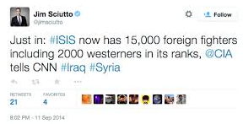


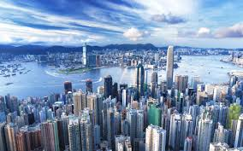
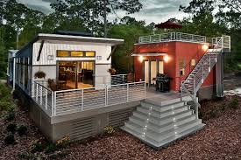
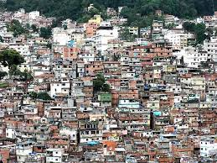
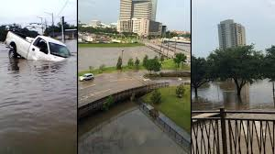
Tarbimine aastal 2050
Riik | 2050 SKP inimese kohta (USD)
USA | $182,359
Saksamaa | $156,940
Jaapan | $106,234
Hiina | $91,179
Indoneesia | $47,925
India | $43,766
Linnad peavad hakkama saama oluliselt kasvanud nõudlusega erinevate teenuste järele
Nõudlus teenuste järele linnades
40%
40%
50%
2014
2030
Vesi
Energia
Toit
Notes:
Consumer behavior may be very different in the future than it is today. Already more distributed energy models, mass urbanization, and growing demand for municipal resources are creating new challenges for policy makers and businesses. Additionally, we may see up to 400 million Chinese enter the middle class in the next couple of decades. Their preferences for cars, appliances, and entertainment will have drastic impact on energy demand.
Many expect the West will maintain its dominance in terms of per capita GDP, however, Asia and Africa will see rapid growth in GDP and mass urbanization. In some regions, growth in squatter cities outpaces non-squatter urban population growth (or makes up a significant portion of total urban growth). There will need to be smart innovations to cater to these sizable populations with drastically different needs.

Slide 49
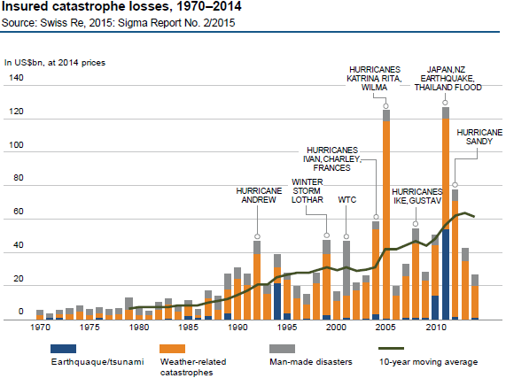
Kliima muutub
“Ekstreemsete ilmastikunähtuste sagedus on kasvanud 4 korda, 1980 registreeriti 38, 2014 aga 174 juhust.“
Source: 2015 - World Energy Perspective - The road to resilience − managing and financing extreme weather risks

Slide 50
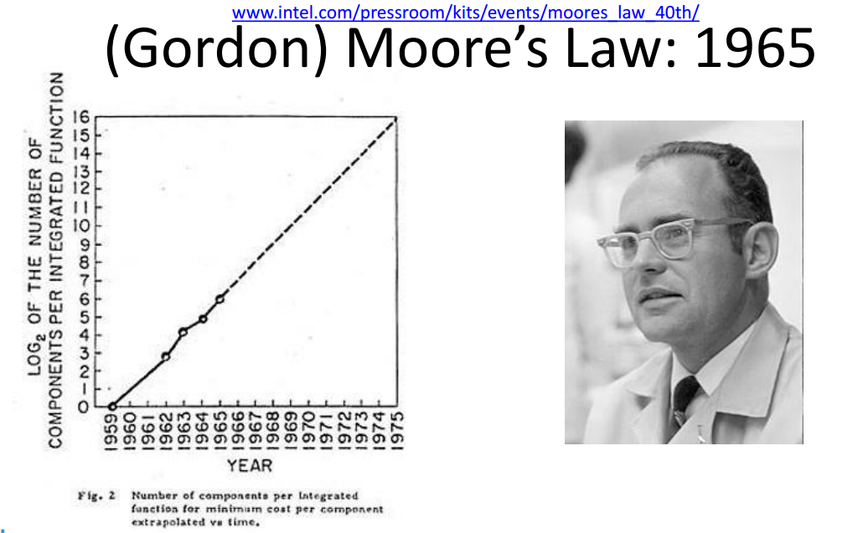
Arvutustehnika areng
Moore’i seadus peab jätkuvalt paika, kas ka kui kaua ka edaspidi?
Võimalikud tagajärjed:
Geo-engineering
Kaugtöö
Kaugpuhkus
Masinad disainivad masinaid
Optimaalne transport
…

Slide 51
Veel potentsiaalselt olulisi trende
Tehnoloogia
Ärimudelid
Kliimamuutus
3D printimise mõju transpordile
Elektri salvestamine
Arvutustehnika areng
Võrkude tulevik
Elektrisõidukid
CO2 hind
Jagamise-majandus
COP21
Kohanemine või ennetamine
Energia
Tarbimine
Geopoliitika
Energia, vesi, toit
Aafrika
Hiina keskklass
Demokraatia lõpp?
OPEC-i lõpp?
Natsionalism, regionalism, globalisatsioon

Slide 52
Scenarios 2050

Slide 53
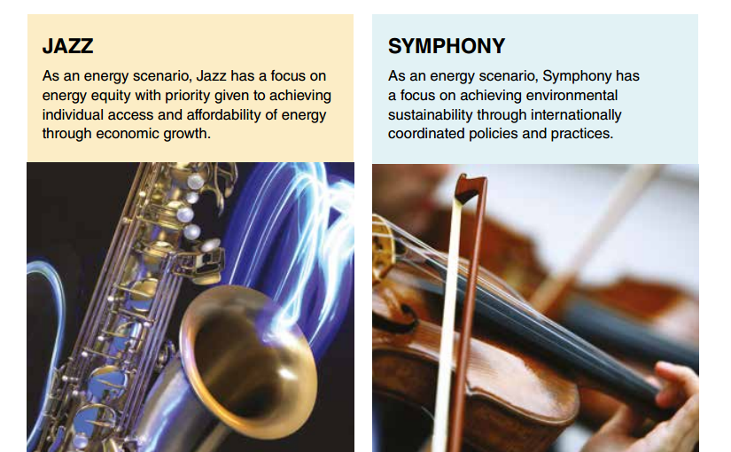
Džäss või sümfoonia?

Slide 54
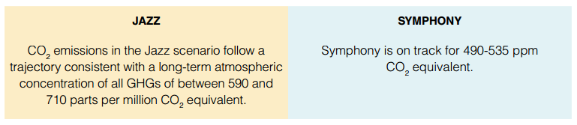
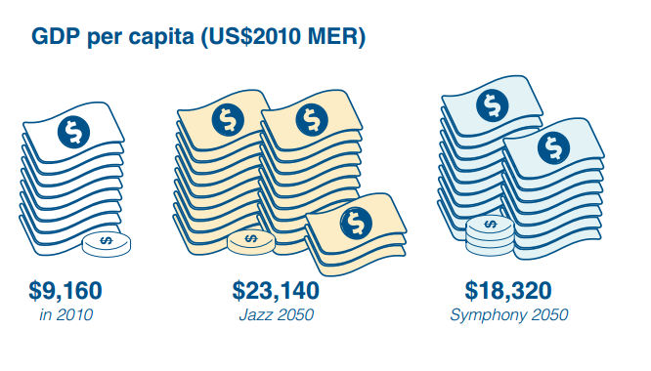
Kliima ja majandus

Slide 55
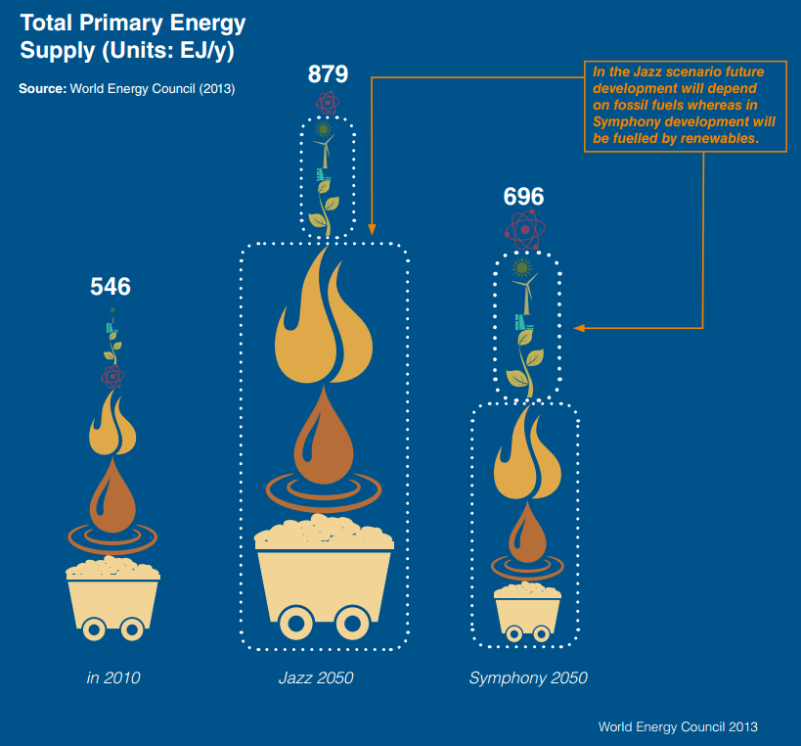
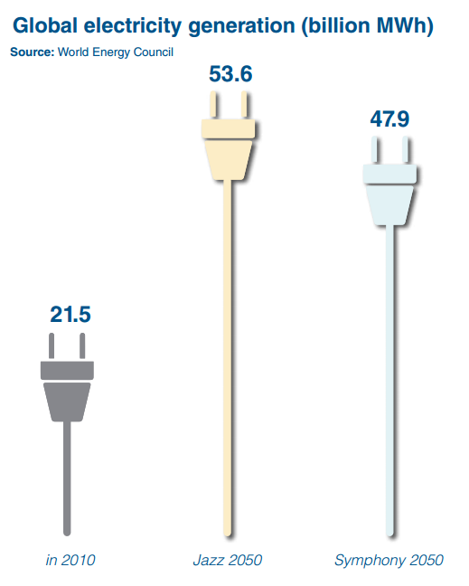
Energiaga varustatus 2050. a

Slide 56
Mõned olulisemad näitajad
 | 2010 | Jazz | Symphony
Maailma rahvastik | 7 mld | 8,7 mld | 9,3 mld
SKP in kohta | 9 000 USD | 23 000 USD | 18 000 USD
Autode arv 1000 in kohta | 124 | 244 | 193
Kliimapoliitika |  | Piiratud | Tugev
Energia efektiivsus |  | Kasvab | Kasvab kiiresti
Primaarenergiaga varustatus | 546 EJ | 879 EJ (+61%) | 696 EJ (+27%)
Fossiilkütuste osakaal | 79% | 77% | 59%
CO2 emissioon | 30,5 Gt/aastas | 44,1 Gt/aastas | 19,1 Gt/aastas

Slide 57
Arutelu
Millised olulised trendid on puudu?
Millised ebaolulised trendid on käsitletud?
Millised trendid on valesti käsitletud?

Slide 58
Tänan!
Mihkel Härm
Mihkel.Harm@wec-estonia.ee

